Slide 1







Understanding our brain:
Open Science in Health and Technology
European Open Science Cloud
Vienna, 23rd November 2018
Viktor Jirsa

Slide 2
Question oriented research
How do we land on the moon?
How do we cure cancer?
How does the brain work?
Concrete results and solutions for concrete questions of high impact on our society
Mind set on interdisciplinarity with no borders : open science

Slide 3
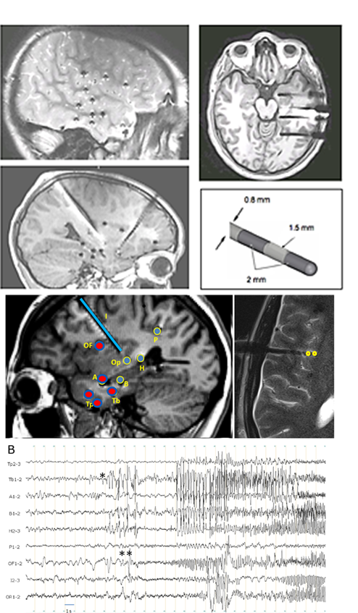
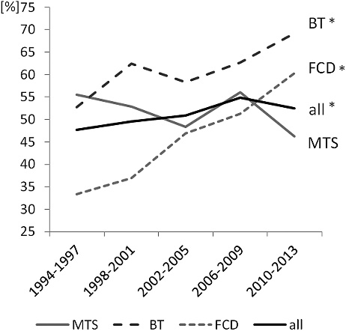
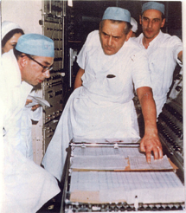
Focal drug resistant epilepsy and surgery
Drug resistant focal epilepsies are severe diseases affecting young people (1% of the world population, high morbidity and mortality)
Epilepsy surgery is the only potential curative treatment and consists in the removal of the most epileptogenic brain regions
Includes depth electrodes implantation to record the intracerebral EEG signals (stereoelectroencephalography, SEEG)
Failures (complete or partial) in about 40% (particularly in extra temporal lobe epilepsy)
No significant improvement of surgery success rate in 50 years
Jean Bancaud, Jean Talairach
Paris in 1960s

Slide 4
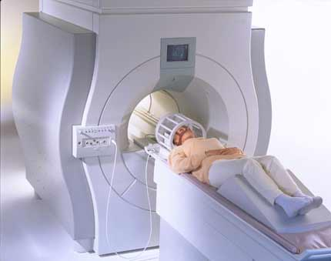

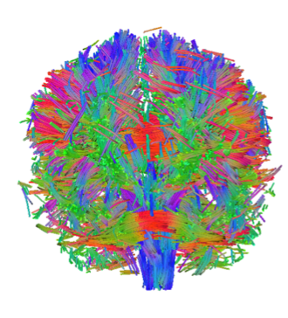
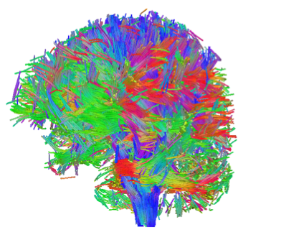
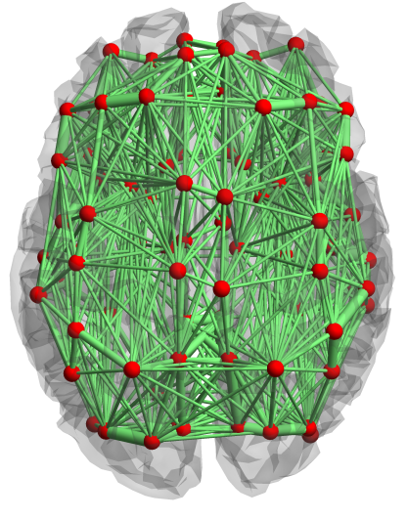
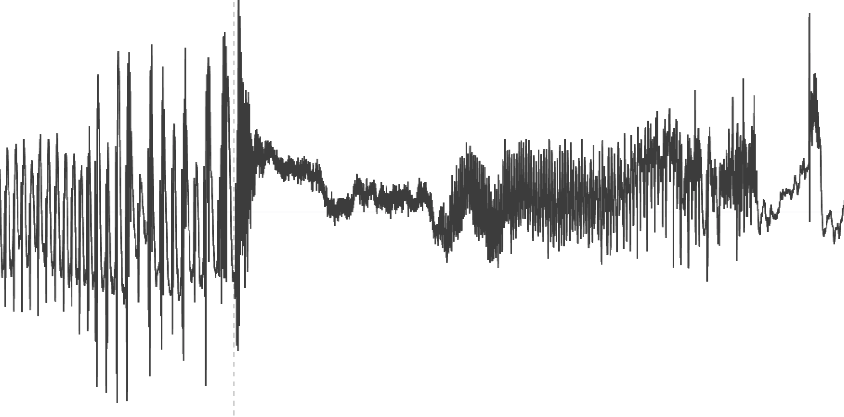
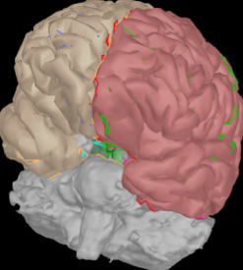
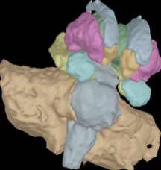
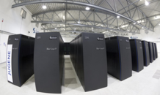

Virtualization of personalized brain networks
Noninvasive brain imaging
Network science & Connectomics
Construction of functional brain avatar
Therapeutic Intervention
1990s
Magnetic Resonance Spectrography (MRI)
Diffusion Imaging (DTI, DSI)
2000s
Large-scale brain network modeling
Graph theoretical analyses
Connectome
2010s
Large-scale brain network modeling
Graph theoretical analyses
High Performance Computation
2020s
Clinical trial EPINOV
Personalized Medicine
Bio-inspired computation
OPEN SCIENCE TOOLS
Brian, Brainstorm, Anywave, The Virtual Brain, Human Connectome Project
HBP –Joint Platform
European Open Science Cloud
SPM, DCM, PSL, …
FSL, MrTrix, FreeSurfer, …

Slide 5
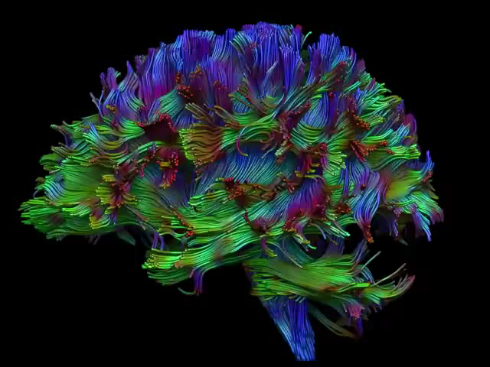
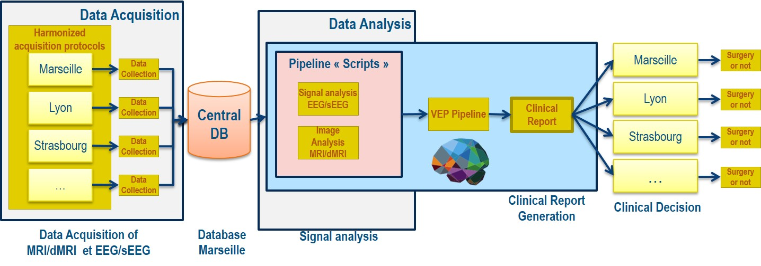
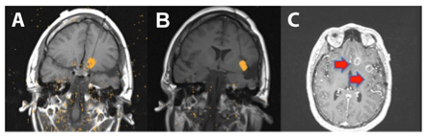
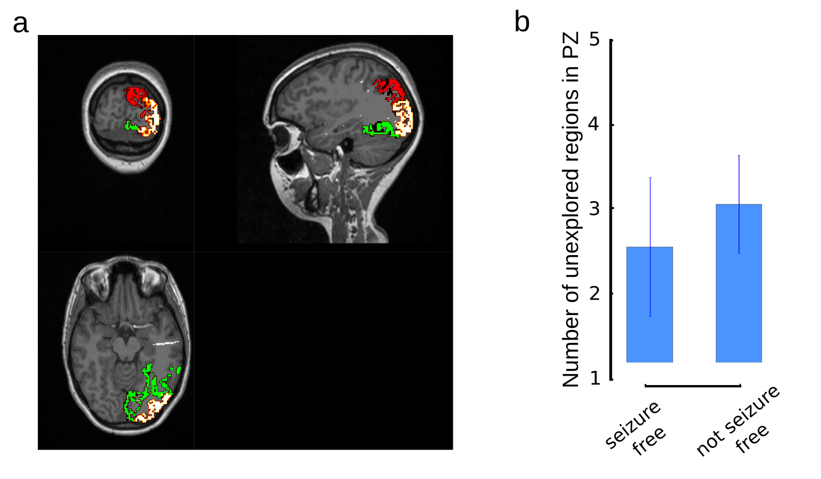
Clinical trial EPINOV: 2019-2022
First clinical trial:
randomized parallel-group study clinical trial
(coordinator: F. Bartolomei; scientific director. V. Jirsa)
Objective:
evaluate personalized Virtual Epileptic Patient brain models for surgery planning and outcome
12 French clinical centers
400 prospective patients
2019 – 2022
*
Improvement of predictive power through virtual brain technology : 20%
2 retrospective cohorts with 15 and 25 patients
(Jirsa et al. Brain 2014, Neuroimage 2016; Proix et al. Brain 2017, Nature Comm 2018)

Slide 6
Better Integration and progress through Open Science
High impact necessitates interdisciplinarity.
Interdisciplinarity implies no borders.
Open Science is not optional, but conditio sine qua non.

Slide 7


